Slide 1
WELCOME
Weekly Report
Vatsla Adhikari
Nov. 19, 2023

Slide 2
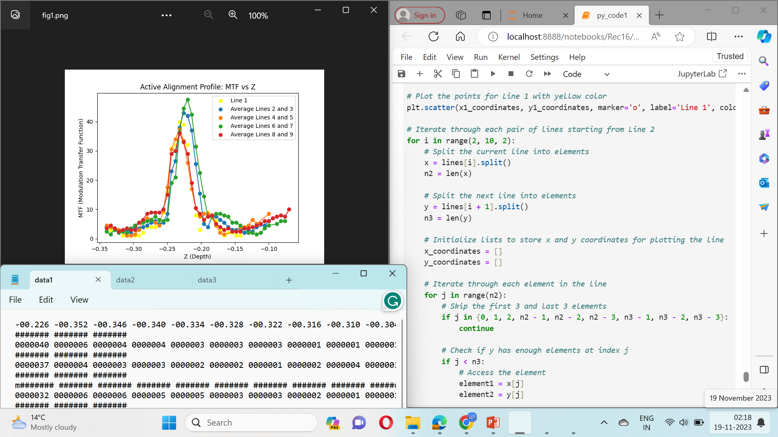
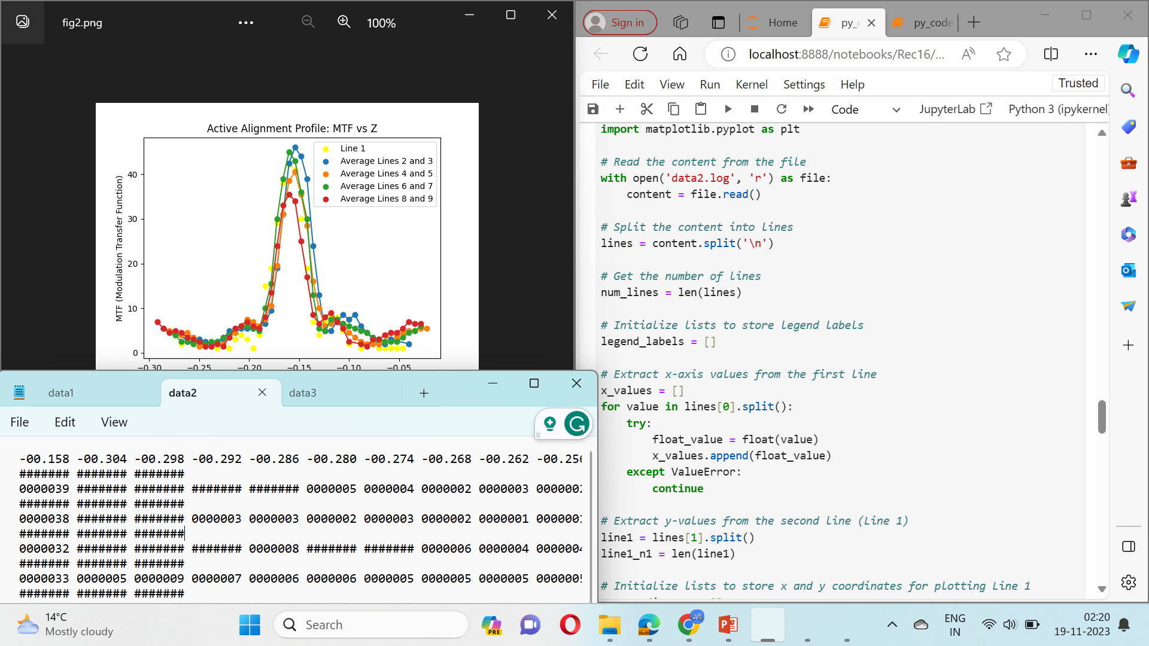
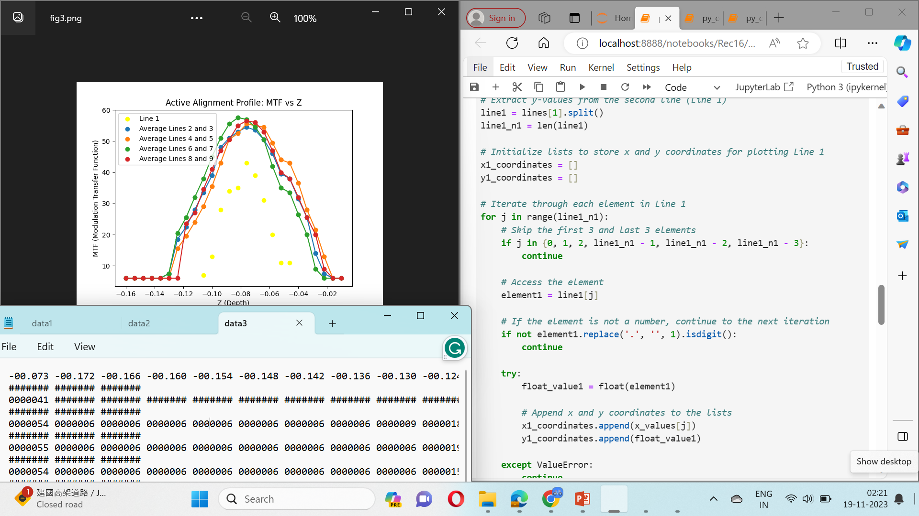
Plotting the Active Alignment Profile for 3 Datasets
(Format: code-output-data)

Slide 3
Thank You!
REC Technology
Corporation
瑞柯科技
股份有限公司

